Slide 1

Employee attrition Analysis
Vijayasrikanth kaniti

Slide 2
Introduction
Provide employee attrition analysis to DDS Analytics company
Identify various trends or insights from data
Predict Attrition and Monthly income for given test data sets
Make recommendations for HR to improve talent management
Used R language to do the Data Analysis and prediction

Slide 3
Preprocessing data
Removed variables which holds constant value across data set (EmployeeNumber,Over18,StandardHours)
No Missing values.
Converted Categorical variables to Numerical variables.
Removed outliers by performing linear regression and cooks distance

Slide 4
Data exploration
Performed Linear regression modelling to remove variables which are not significant for Attrition
Performed correlation technique to check if there is relationship between variables. Identified top three variables that effect Attrition rate by checking correlation coefficient.
Significant Attributes from Data Set
Businesstravel
Department
Distancefromhome
EnvSatisfaction
Jobinvolvement
Jobsatisfaction
Maritalstatus
Numcompaniesworkd
Overtime
Relationshipsatisfaction
Worklifebalance
Yearsincelastpromotion

Slide 5
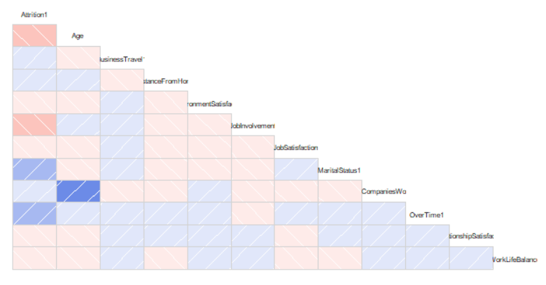
Correlation
Top three factors that attributes Attrition rate are
Age
Job Involvment
Over Time

Slide 6
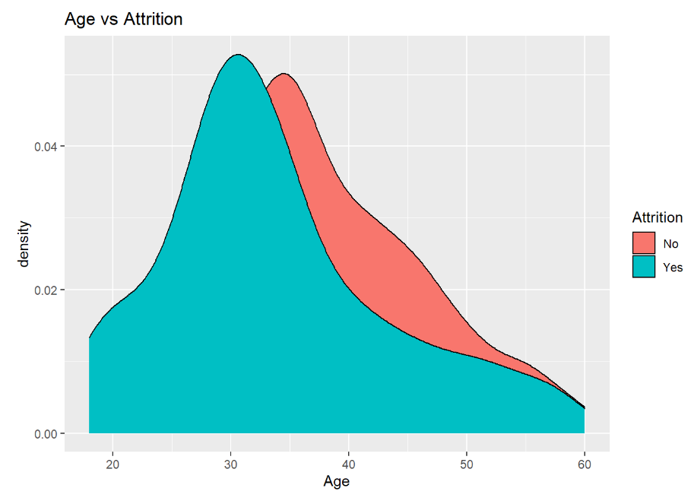
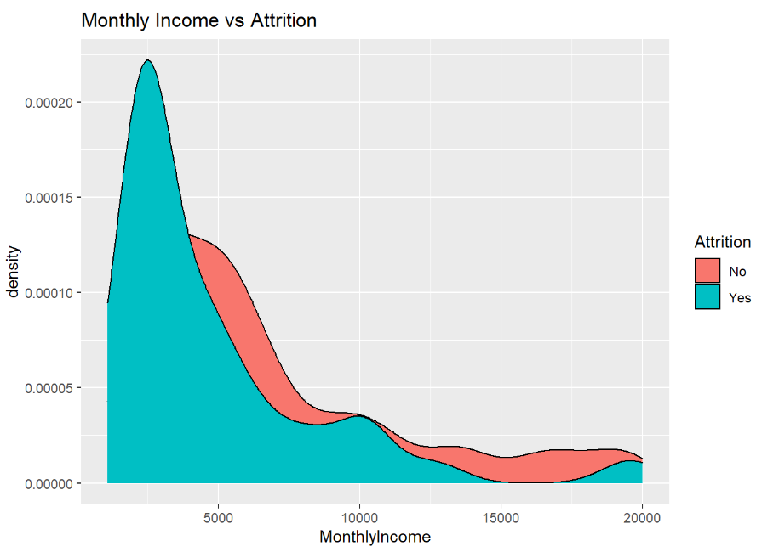
Insights…
Employees who are younger have high attrition rate
Employees who have less monthly Income have high attrition rate

Slide 7
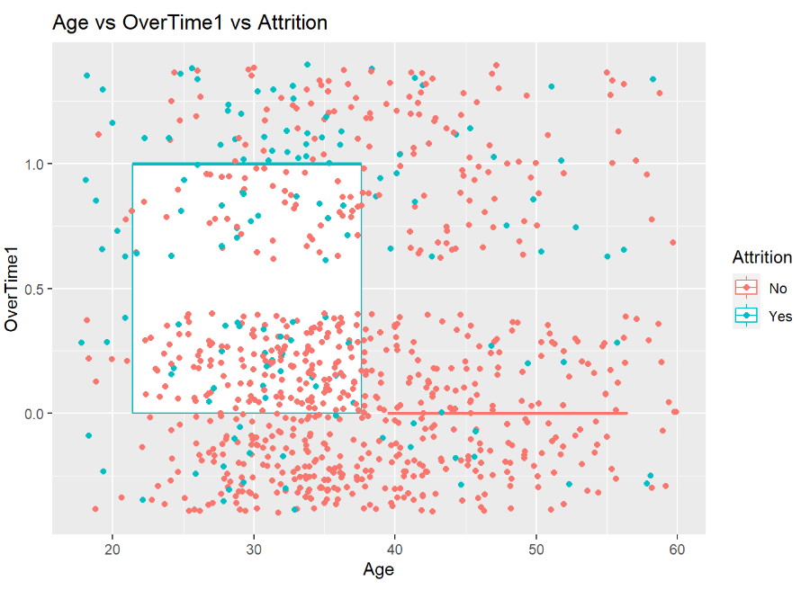
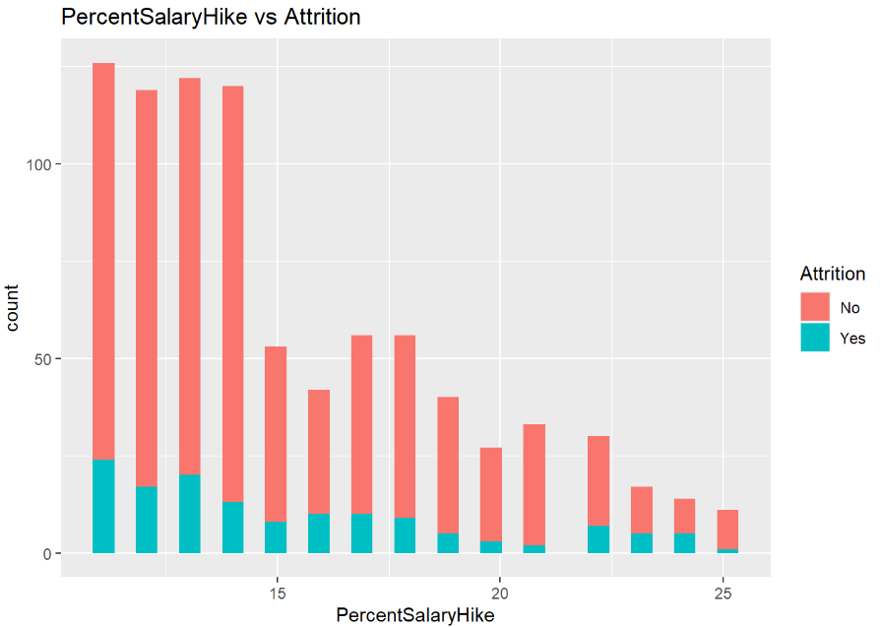
Insights…
Employees who works overtime and younger Age have attrition rate
Employees who have less salary hike have a sign of high attrition rate

Slide 8
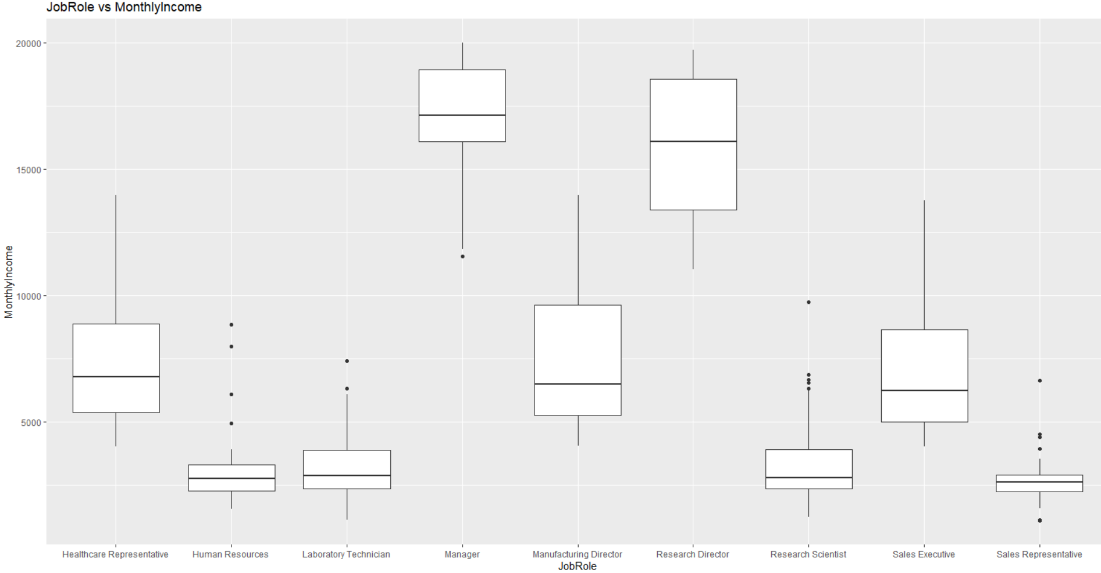
Managers and Research Scientist have high median income than other Job roles.
Insights…

Slide 9


Prediction modelling
Performed KNN and Naïve Bayes Modelling for classification and prediction of attrition rate,
 | KNN | NAÏVE BAYES
ACCURACY | 85.19% | 80.65%
SPECIFICITY | 2% | 62.86%
SENSITIVITY | 99% | 84.07%
Naïve Bayes model gives the better output than KNN with this dataset

Slide 10
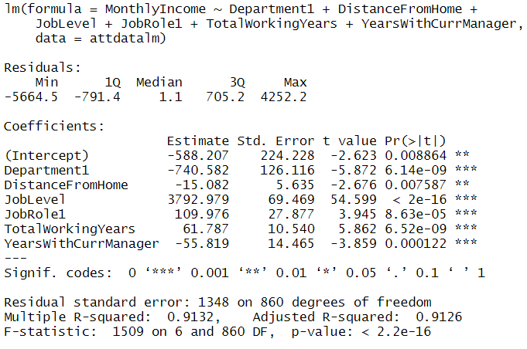
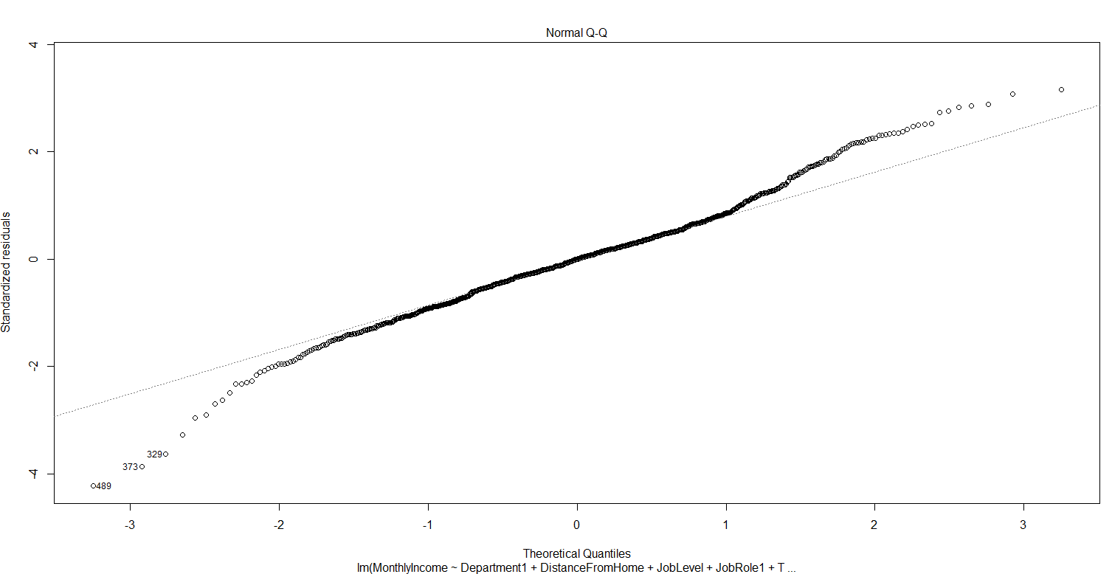
Linear regression for monthly income prediction
Factors that are significant for Monthly Income prediction are as below
Department+DistanceFromHome+JobLevel+JobRole+TotalWorkingYears+YearsWithCurrentManager
RMSE=1339.671 <3000

Slide 11
Conclusion
Employees making less than $5000 /month have highest attrition rates
Over Time, Age, Marital Status and Job Involvement are top factors for attrition rate
Employees with less than 5 years of company or 5 total working years are more likely to leave
Naïve Bayes provides the best prediction model with an accuracy rate of 81.94%

